Slide 1
Pointers
CS217 – Object Oriented Programming

Slide 2
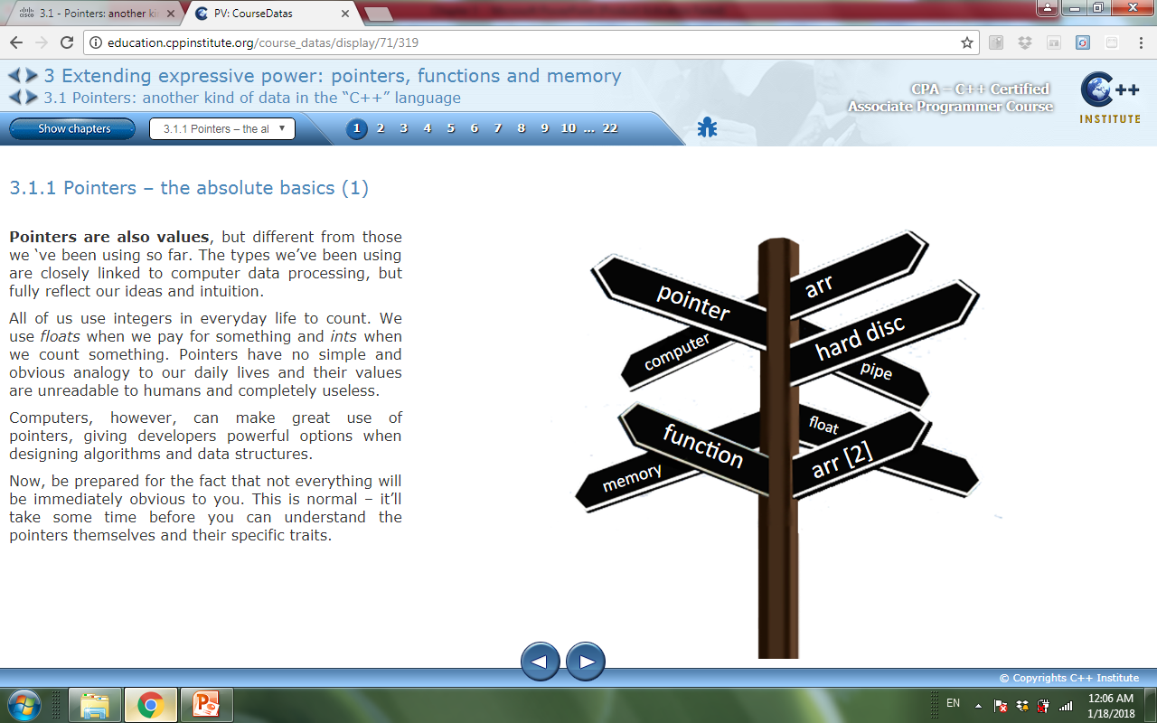
Pointers – the absolute basics
Pointers are memory locations used to save values in C++.
Pointers are different from other types.
The types we’ve been using are closely linked to computer data processing and reflect our ideas and intuition.
Integers are used to count.
floats used when pay for something.
Pointers have no simple and
obvious analogy to our daily lives
and their values are unreadable to humans and completely useless.

Slide 3
Pointers – the absolute basics
Each declared variable occupies a small piece of the computer memory. The attribute of where this value is stored is called the address.
Difference between variable content and address:
The value of the variable is what the variable stores;
The address of the variable is information about where this variable is placed.
Pointers are used to store information about the location (address) of any other data.

Slide 4
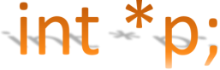

Pointers Declaration: The first pointer
To declare an integer pointer we use the following syntax:
This declaration sets up a variable named p. It isn't an int - the asterisk (*) means that p is a pointer - and will be used to store information about the location of the data of type int.
The pointers are always used to point to the specific data referred to in the declaration.

Slide 5
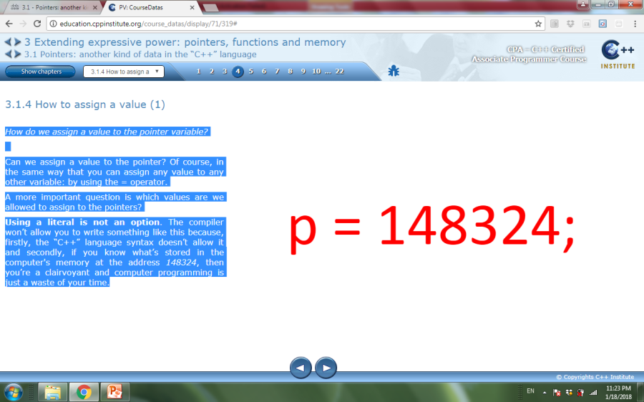
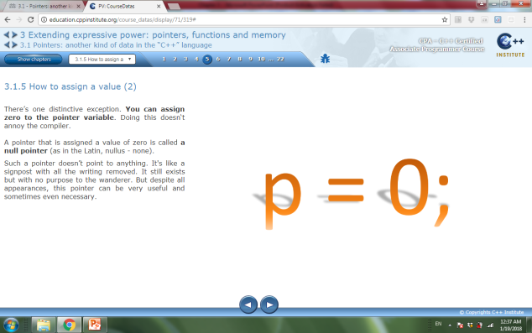
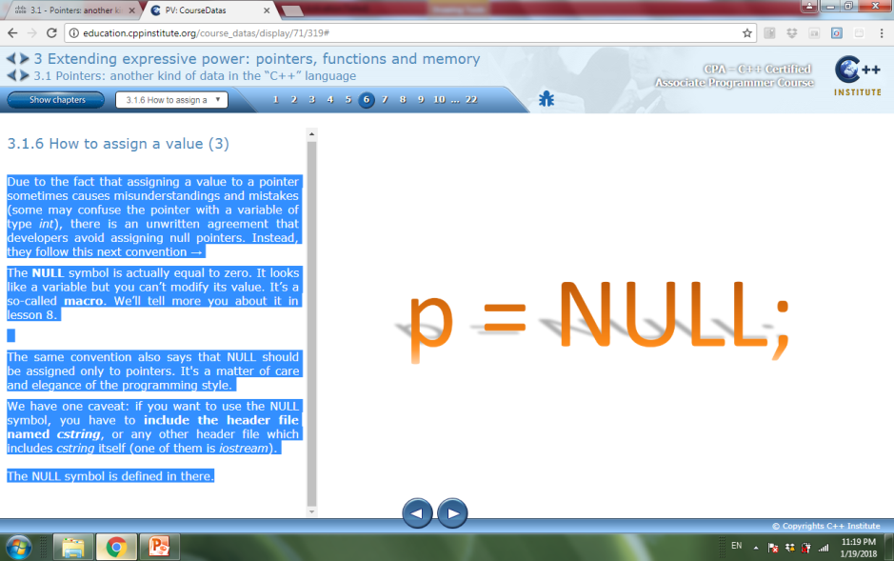

How to assign a value
How do we assign a value to the pointer variable?
by using the = operator.
Using a literal is not an option; the “C++” language syntax doesn’t allow it.
There’s one distinctive exception. zero can be assigned to the pointer variable.
OR
A pointer that is assigned a value of zero is called a null pointer.
A null pointer doesn’t point to anything.

Slide 6
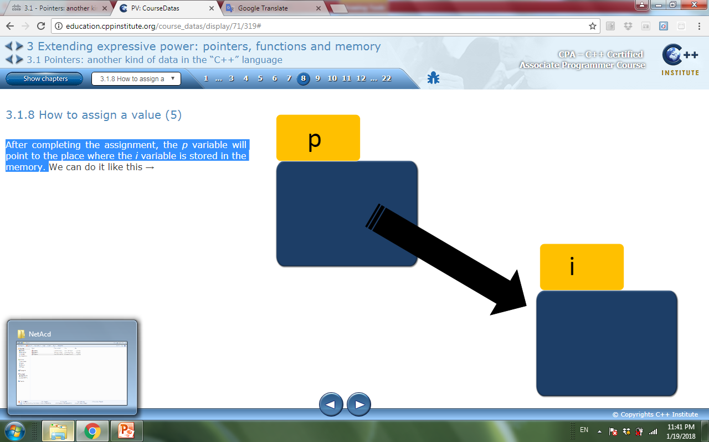
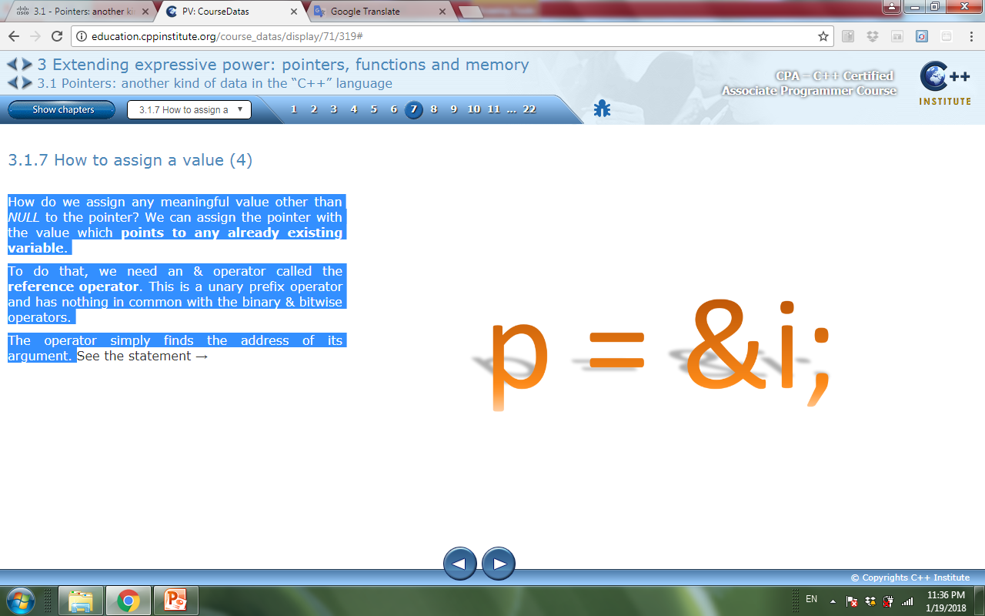
How to assign a value
Pointers can be assigned the value which points to any already existing variable.
To do that, we need an & operator called the reference operator.
The & operator is a unary prefix operator
The operator simply finds the address of its argument.
After completing the assignment, the p variable will point to the place where the i variable is stored in the memory.

Slide 7
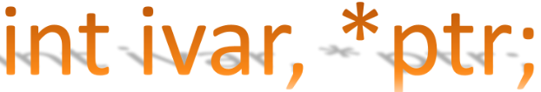
How to assign a value
How do we get a value pointed to by the pointer?
Answer: We can dereference it.
Dereferencing is an operation where the pointer variable becomes synonymous with the value it points to.
To declare a variable of type int(ivar) and a variable of type int * (ptr). We can do it within a single statement

Slide 8
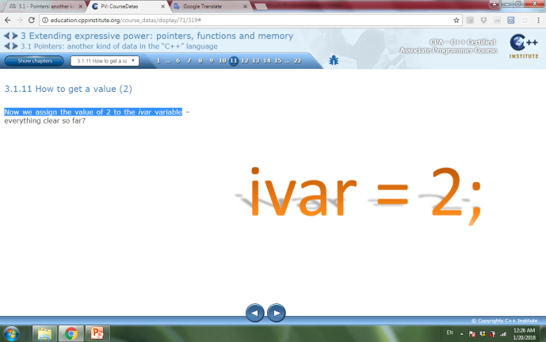
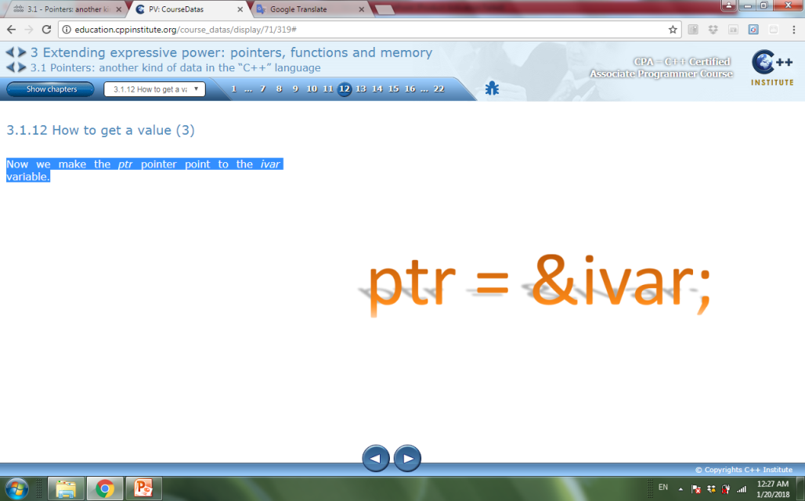
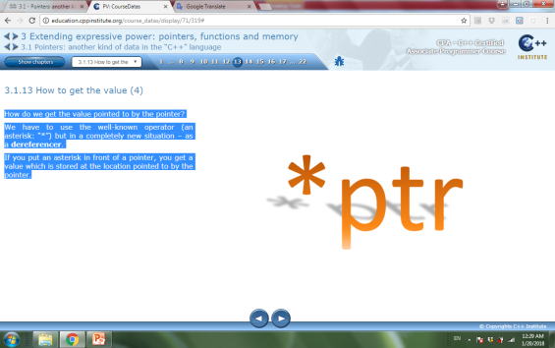
How to assign a value
To assign the value of 2 to the ivar variable.
Now we make the ptr pointer point to the ivar variable.
To get the value pointed to by the pointer we have to use the operator (an asterisk: “*”) but in a completely new situation – as a dereferencer.
If you put an asterisk in front of a pointer, you get a value which is stored at the location pointed to by the pointer.
Dereferencing NULL pointers is forbidden and leads to serious problems very quickly.

Slide 9
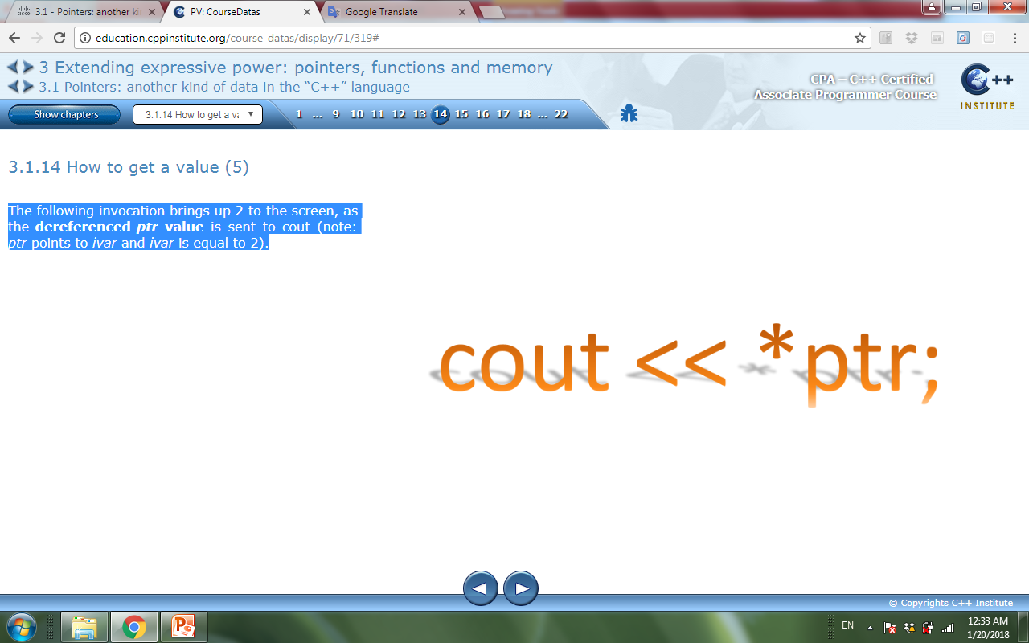
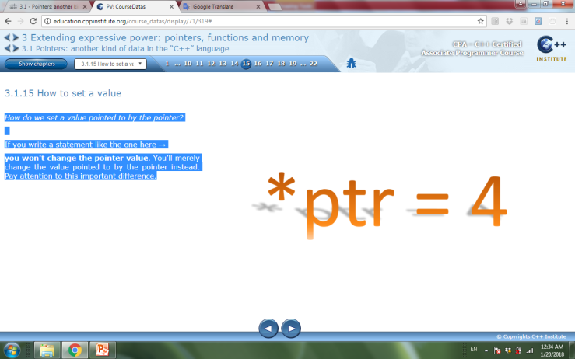
How to assign a value
To print the value pointed to by the pointer
To set the value pointed to by the pointer.
This statement won't change the pointer value; it will change the value pointed to by the pointer instead.

Slide 10
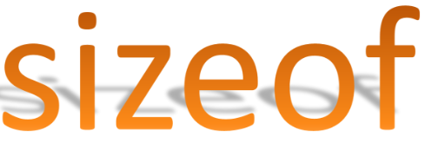
sizeof operator
The sizeof operator is a unary prefix operator with the highest possible priority.
The sizeof operator expects its argument to be a literal or a variable or an expression enclosed in parentheses or the type name.
It is the only “C” operator that allows its argument to be a type.
The sizeof operator provides information on how many bytes of memory its argument occupies (or may occupy).
The sizeof is not only an operator – it’s also a keyword.

Slide 11
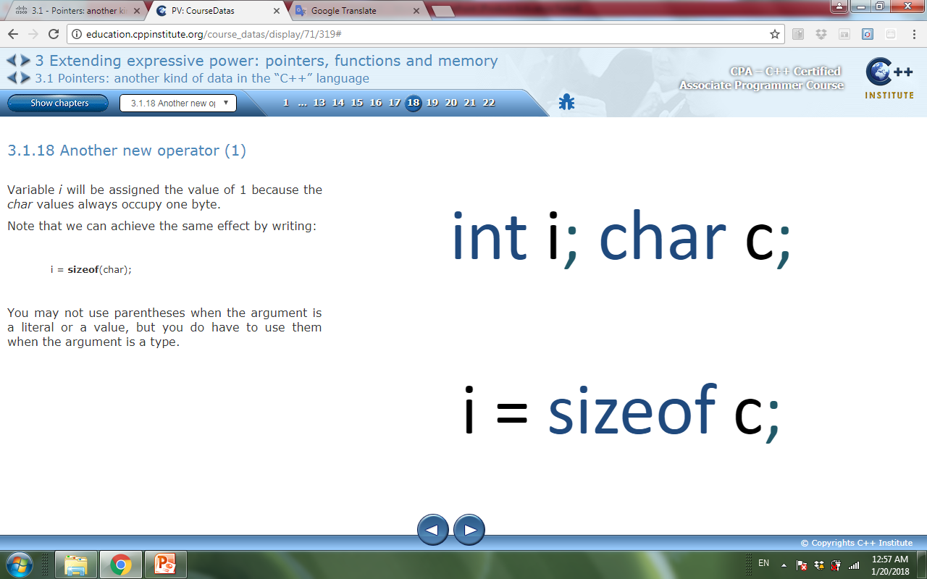
sizeof operator
Example 1:
Variable i will be assigned the value of 1 because the char values occupy one byte.
Same effect can be achieved by writing:
i = sizeof(char);
The parentheses may not be used when the argument is a literal or a value, but you do have to use the parentheses when the argument is a type.

Slide 12
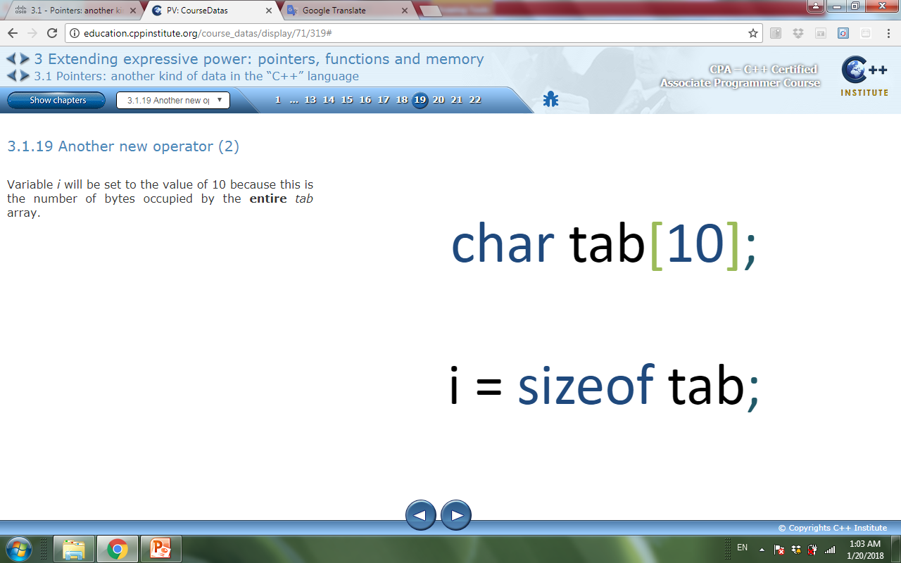
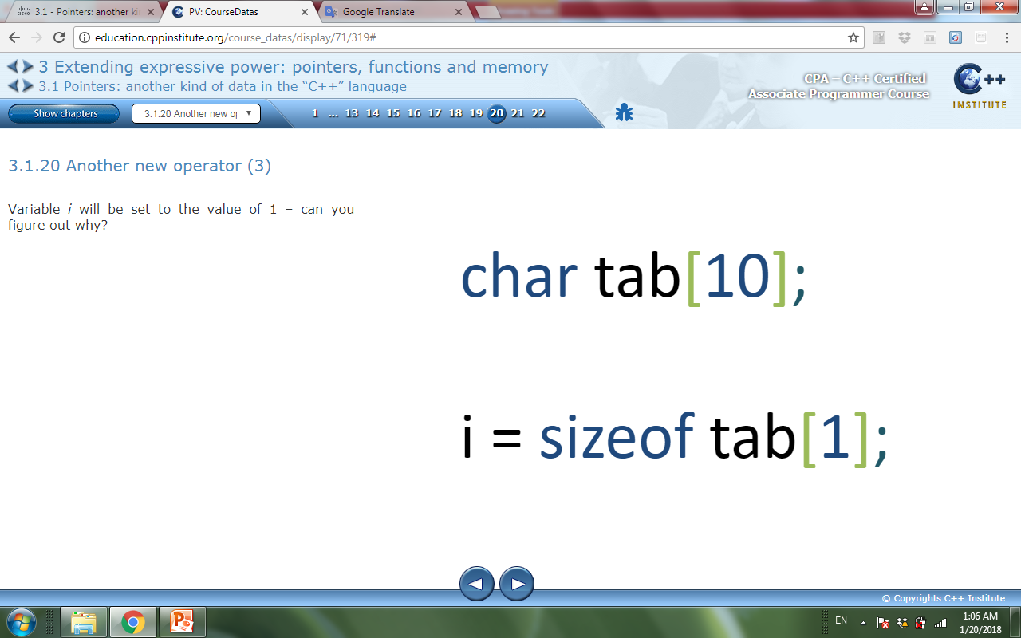
sizeof operator
Example 2:
Variable i will be set to the value of 10 because this is the number of bytes occupied by the entire tabarray.
Example 3:
Variable i will be set to the value of 1

Slide 13
sizeof operator
Example 4: check this out!
#include<iostream>
using namespace std;
int main()
{
char *p; //pointer to char variable
char i; // var of type char
p=&i;
cout<<sizeof(i)<<" "<<sizeof(p)<<endl;
return 0;
}
The output: 1 4
why?

Slide 14
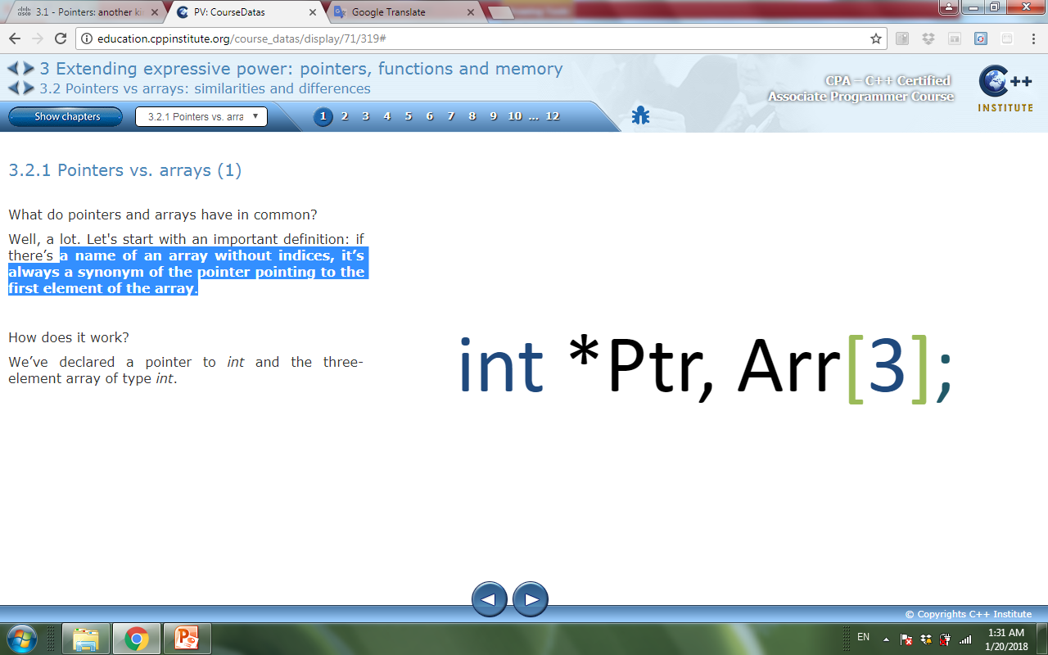
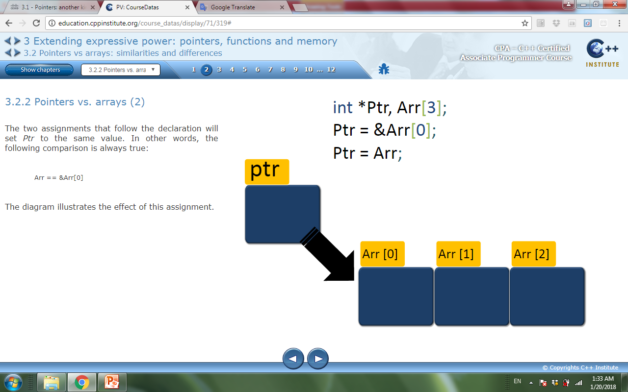
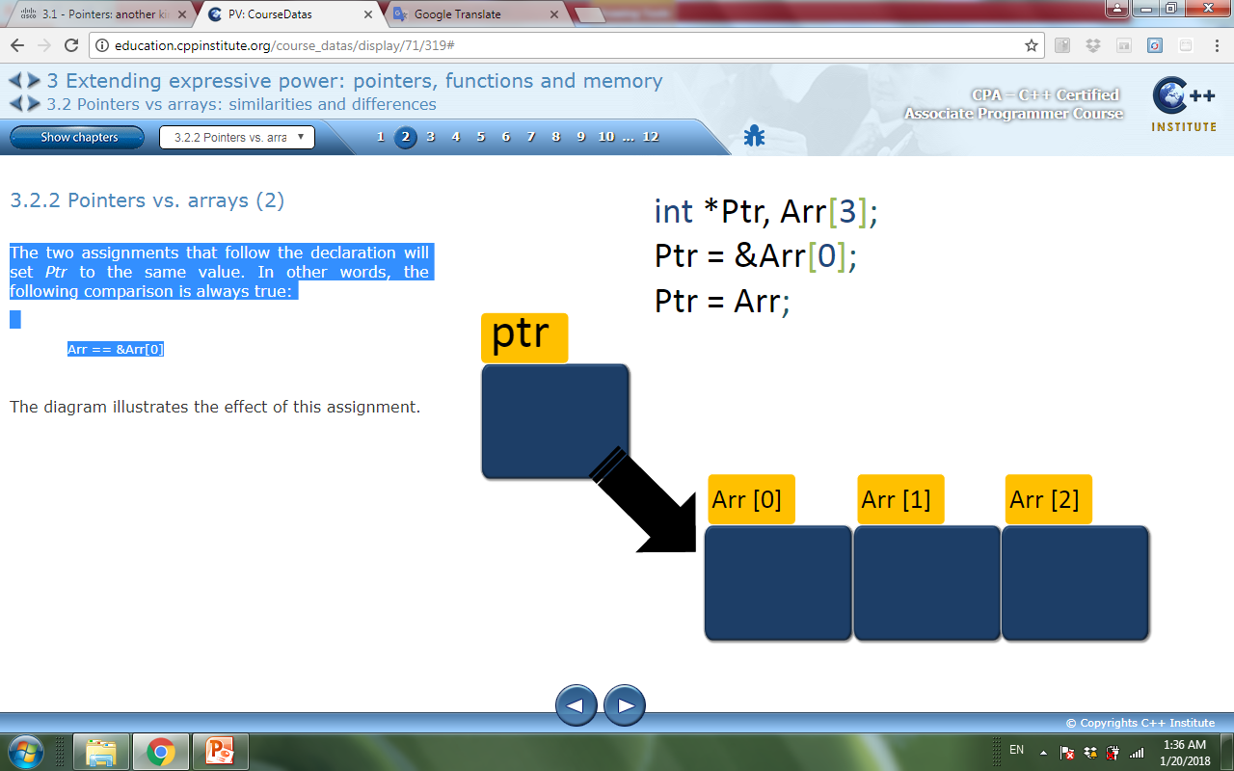
Pointers vs. arrays
The name of an array without indices, it’s a synonym of the pointer pointing to the first element of the array.
Example:
A pointer to int and the three-element array of type int are declared.
These two assignments will set Ptr to the same value. In other words, the following comparison is always true: Arr == &Arr[0]

Slide 15
The pointers' arithmetic
The pointers' arithmetic is different from the integers' arithmetic as it is relatively reduced and allows the following operations only:
Adding an integer value to a pointer giving a pointer (ptr + int → ptr)
Subtracting an integer value from a pointer giving a pointer (ptr – int → ptr)
Subtracting a pointer from a pointer giving an integer (ptr – ptr → int)
Comparing the two pointers for equality or inequality (such a comparison gives a value of type int representing true or false) (ptr == ptr→ int; ptr != ptr → int)
Any other operations are either prohibited or meaningless. These are the only operations you can use.

Slide 16
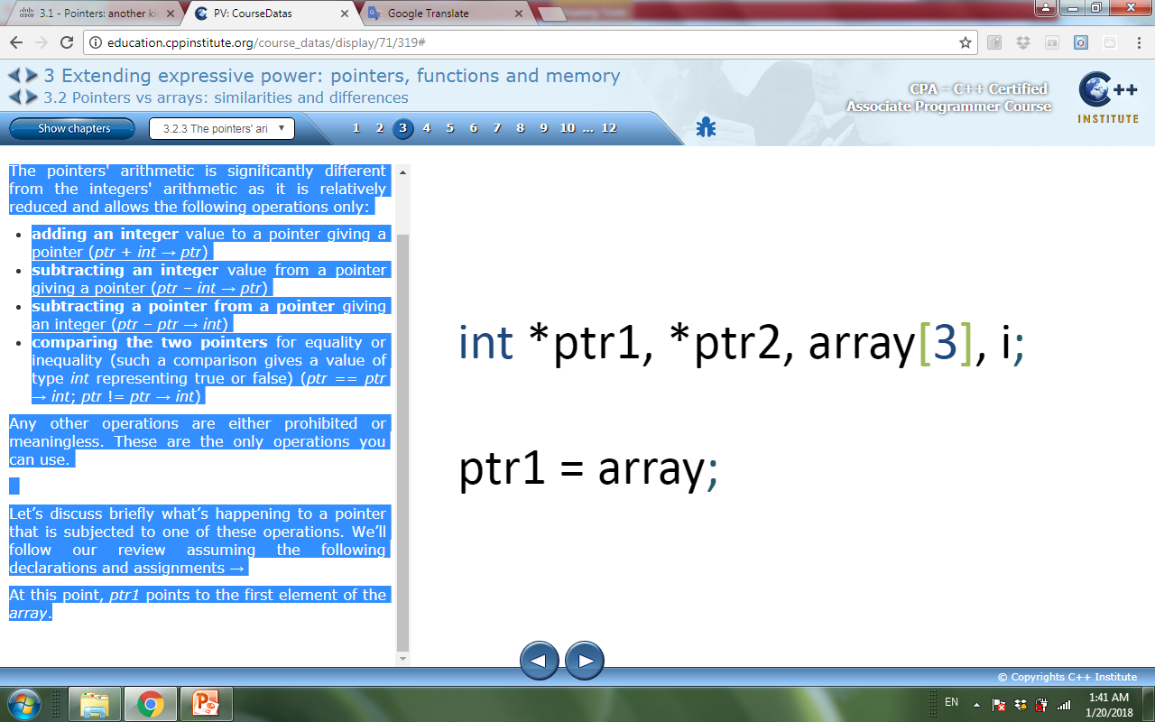
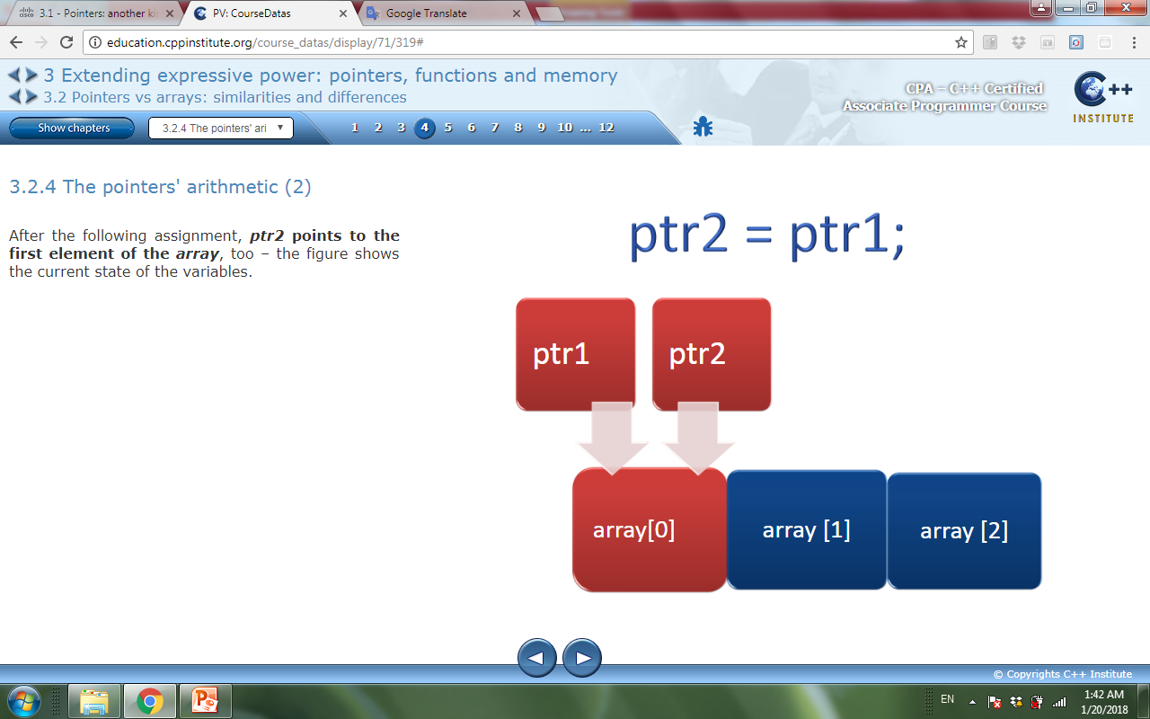
The pointers' arithmetic
Example:
ptr1 points to the first element of the array.
After the following assignment, ptr2 points to the first element of the array

Slide 17
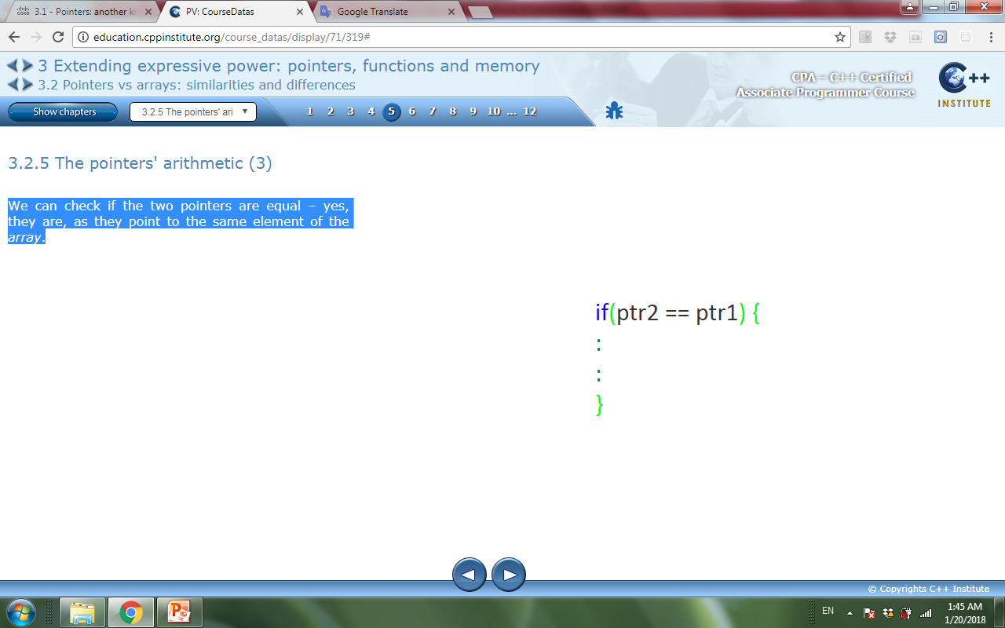
The pointers' arithmetic
To check if the two pointers are equal equality operator is used.
Two pointers are equal if they point to the same memory location or the same element of an array.

Slide 18
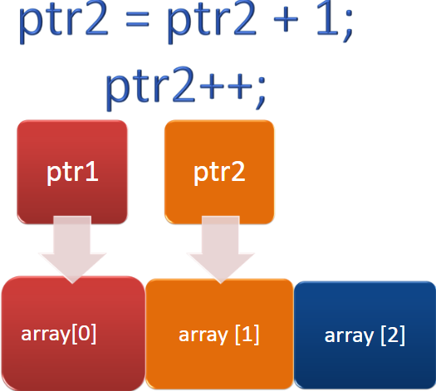
The pointers' arithmetic
To check how addition works. These statements perform the same operation: they add 1 to ptr2.
The interpretation of this operation is as follows:
it’s taken into account what type is pointed to by the pointer - in our example it’s int

Slide 19
The pointers' arithmetic
The addition determines how many bytes of memory the type occupies .
The value we want to add to the pointer is multiplied by the size of the pointer type.
In effect, the pointer moves itself to the next int value in the memory.
What would happen if we added 2 instead of 1 to ptr2 pointer?
In this case, the ptr2 would increase by (2 * 4)
and ptr2 would move through two int values and point to the third element of the array(namely, array[2]).
The comparison: ptr1 == ptr2 is obviously false.
The comparison: ptr1 != ptr2 is true, as both pointers point to completely different data.

Slide 20
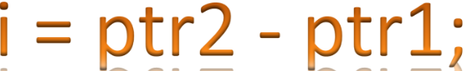
The pointers' arithmetic
The pointers subtraction gives a result of type int. Both pointers need to point to the same type; the compiler will check it.
The final result tells us how many variables of a given type (i.e. int) fit between the addresses stored in the pointers. In our case it’s 1, and this value will be assigned to the i variable.
The result will be greater than 0 if ptr2 points to the memory located after ptr1; otherwise, it’ll be less than 0.

Slide 21
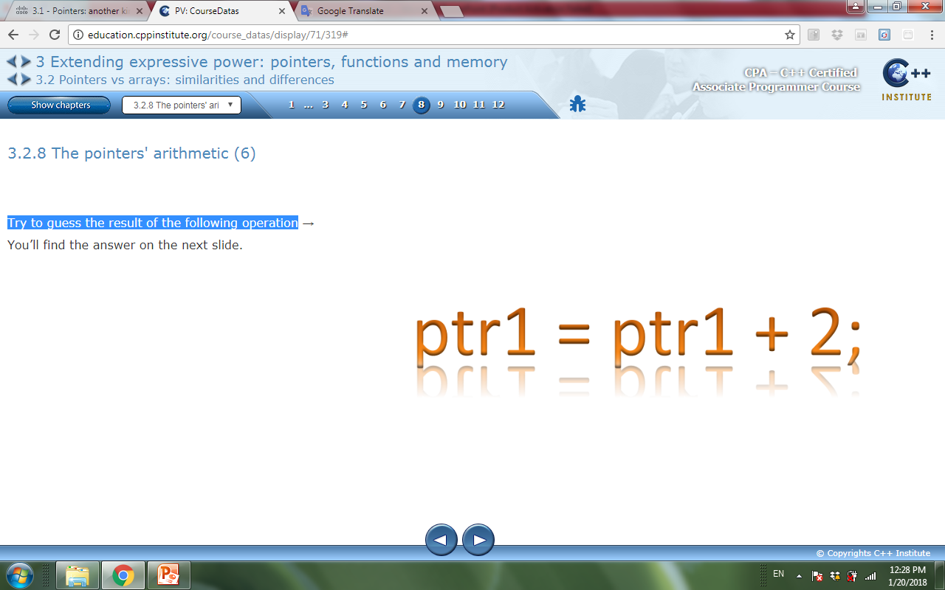
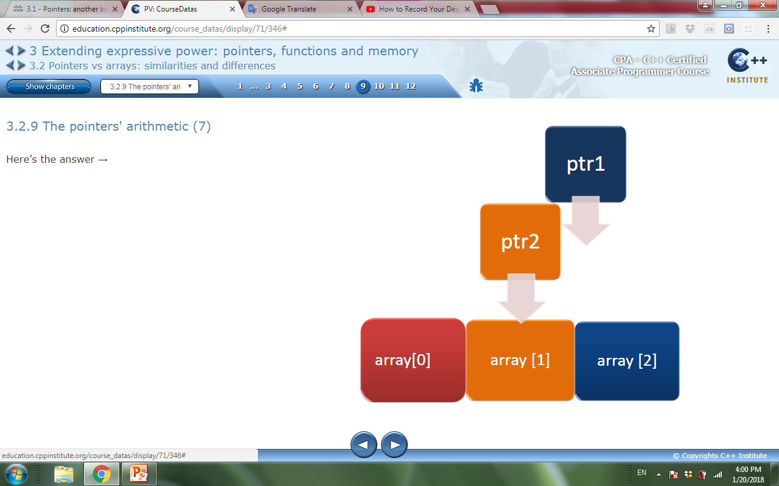
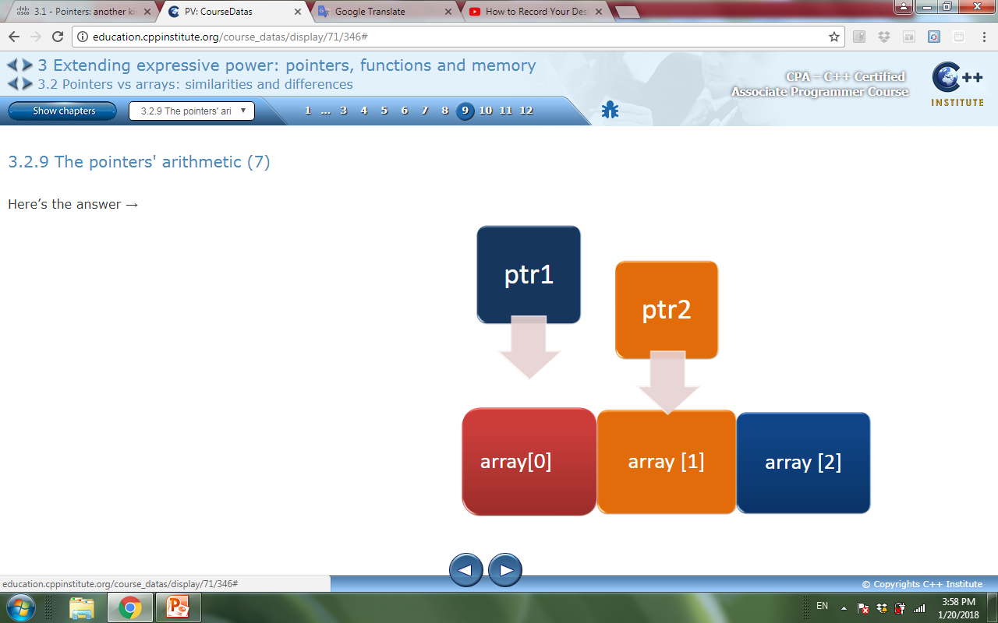
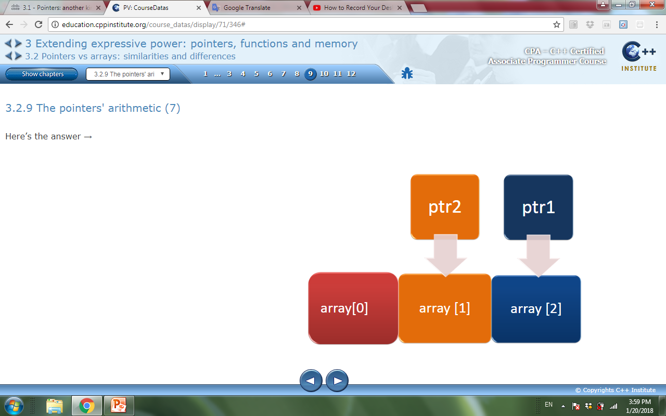
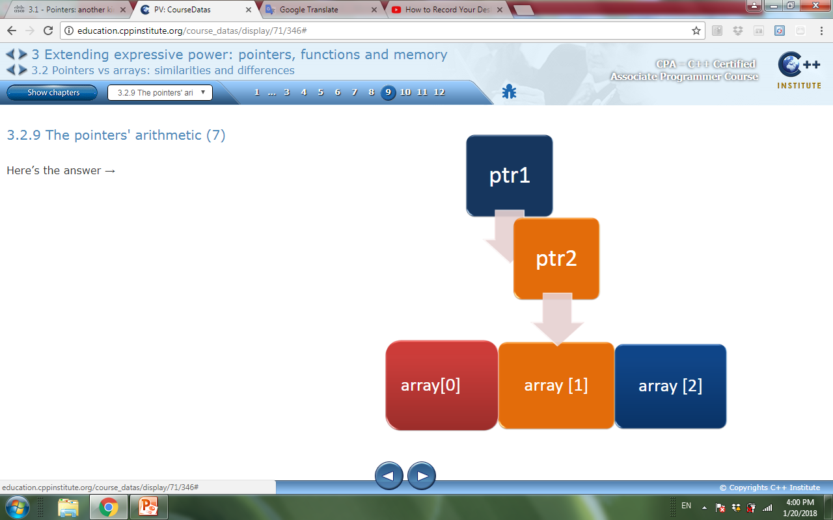
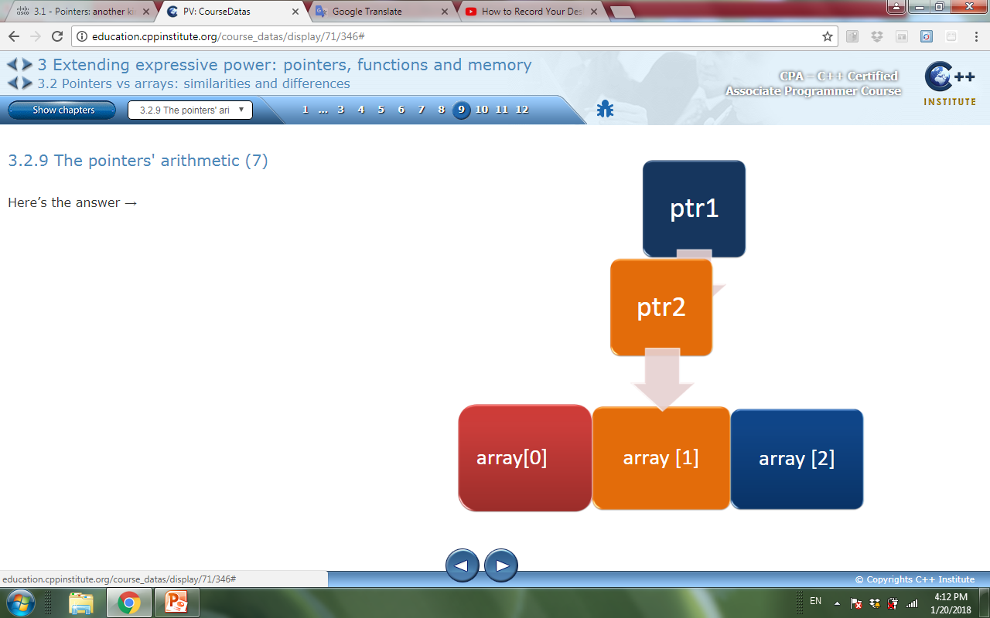
The pointers' arithmetic
What will be the result of the following operation

Slide 22
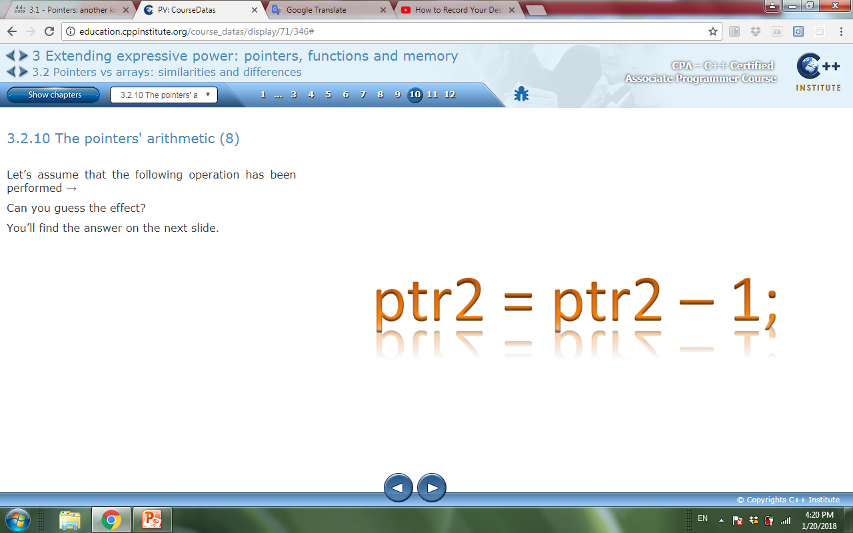
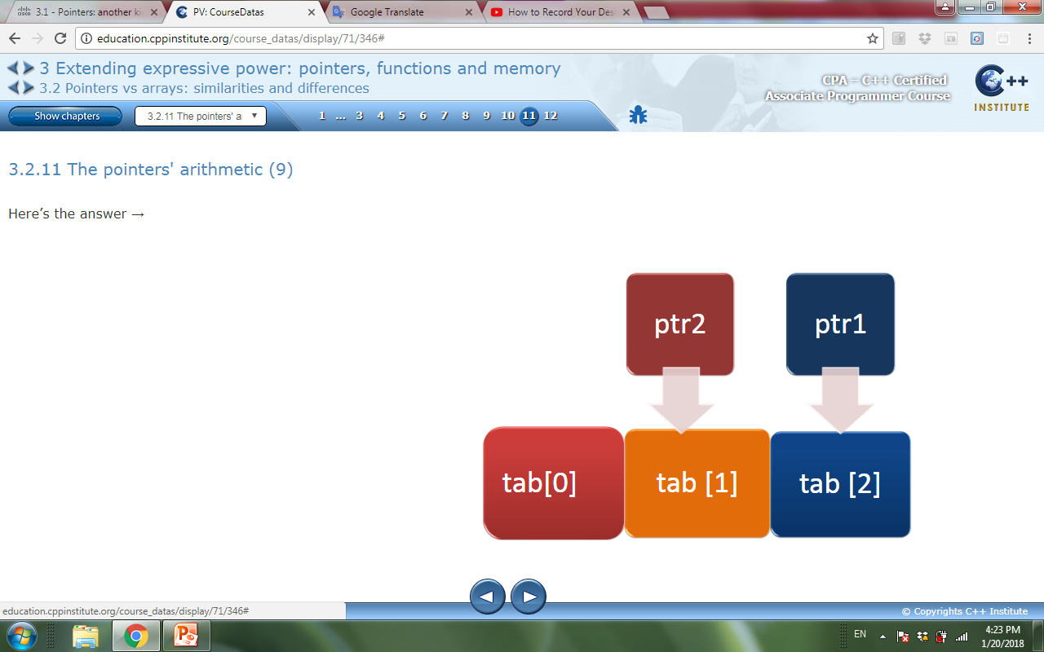
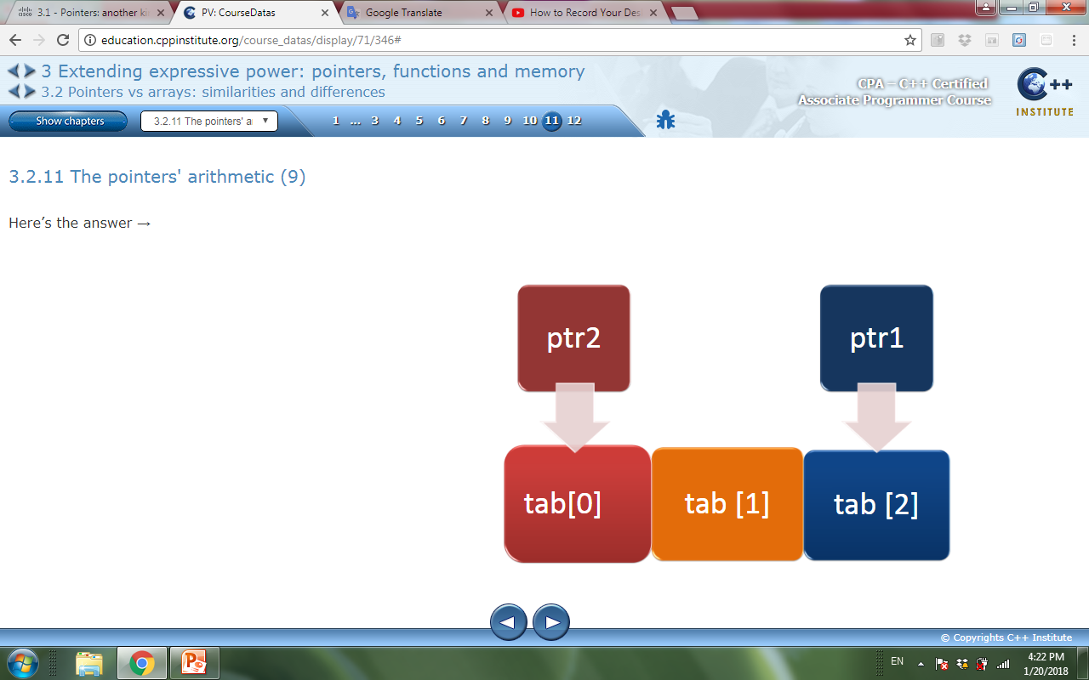
The pointers' arithmetic
Example: Assume the following operation

Slide 23
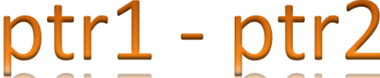
The pointers' arithmetic
Example: What will be the result of the following operation.
Is it 2?
?

Slide 24
Memory on demand
In our examples so far, all work associated with memory allocation was managed by the compiler.
High level languages are designed to spare the developers from such responsibilities.
In some cases, developer wants to have full control over how much memory is used and when exactly it’s used.
When you don’t know in advance what the size of the data to be processed is.
To manage memory (allocating and freeing), the “C++” language gives us two specialized keywords.
new : used to request the creation of a new memory block.
delete : used to release (free) allocated data and return it to the management of the operating system.

Slide 25
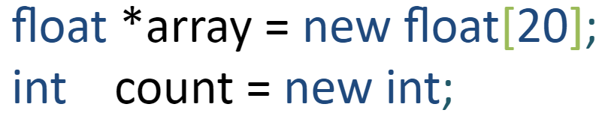

new
The new keyword can be used in the following way:
the new returns a pointer of type conforming to the newly created entity
the newly allocated memory area is not filled (initiated) in any way, so you should expect it to just contain garbage.

Slide 26
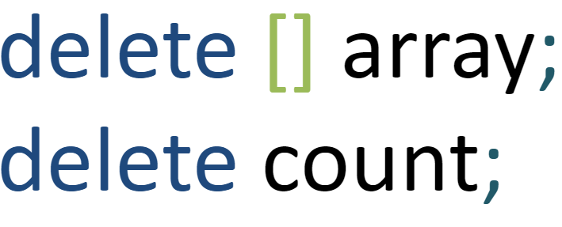
delete
When we no longer need the memory, we can release it (free it) using the delete keyword in the following way:
we use the delete[] form if we want to free up the memory allocated for an array, otherwise we use delete.
you can only release the entire allocated block, not a part of it.
After performing delete, all the pointers that point to the data inside the freed area become illegal;
attempting to use them may result in an abnormal program termination.

Slide 27
Memory on demand – example 1
We declare a variable called arr which will point to the data of type float (the pointer's type is float *); no value is initially assigned to this variable.
We use the new keyword to allocate a block of memory sufficient to store a float array consisting of 5 elements.
We make use of the newly allocated array, then we release it using the delete keyword.
Pay attention to the fact that the pointer returned by new is treated as if it’s an array!
The handling of the dynamic arrays (created during the run of the program) is no different than using regular arrays declared in the usual way.
Regardless of the nature of the array, we can access its elements using [] operator (the same old way).

Slide 28
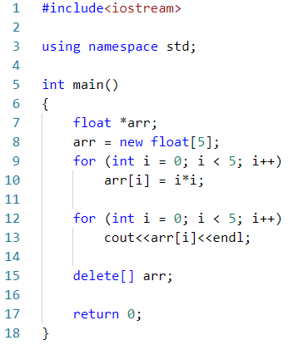

Slide 29


Memory on demand
In the static array, the size must be constant because the allocation is done in the compile time. So, the following code will cause an error:
In the dynamic array, the size can be variable because the allocation is done in the run-time.
int x;
cin>>x;
int arr[x];
int x;
cin>>x;
int *arr = new int [x];

